Slide 1


Slide 2
Contents
1.Topic
2.Summary
Goal
Main stages in accomplishment of the project:
Planning
Realization
Level of difficulty main problems during realization:
3.Going through the code

Slide 3

Topic

Slide 4
Summary

Slide 5

Goal
Our goal was to create a useful application for creating and taking tests on different subjects.

Slide 6
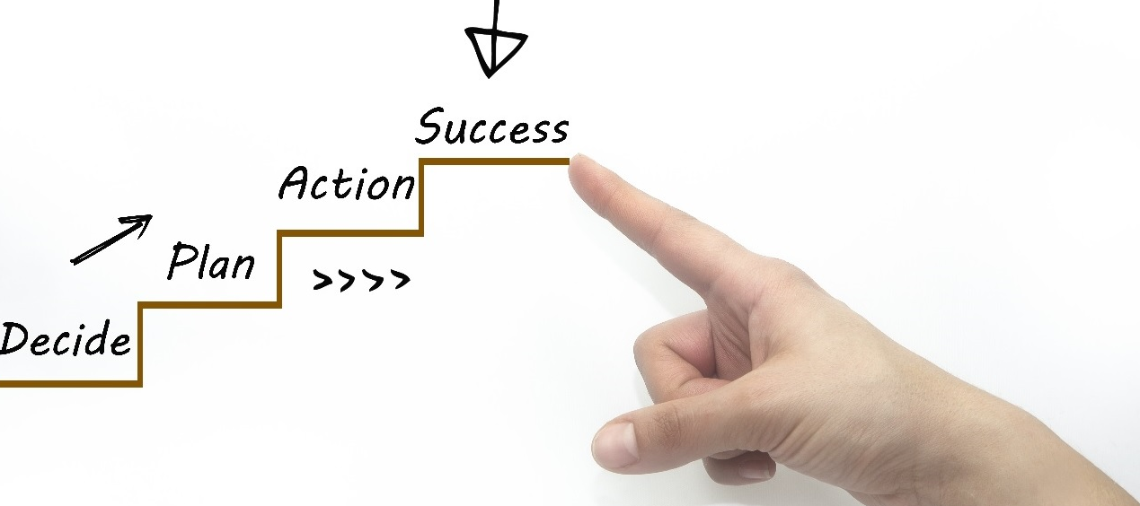
Main stages in accomplishment of the project

Slide 7
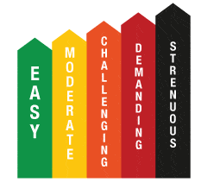
Level of difficulty main problems during realization

Slide 8

Going through the code

Slide 9
Thank you for your time!

